Slide 1
CLAP: Mining Android App Descriptions for Permission Requirements Recommendation
Xueqing Liu, Yue Leng, Wei Yang, Chengxiang Zhai, Tao Xie
Notes:
My name is Xueqing,
I’m here to present our work:

Slide 2
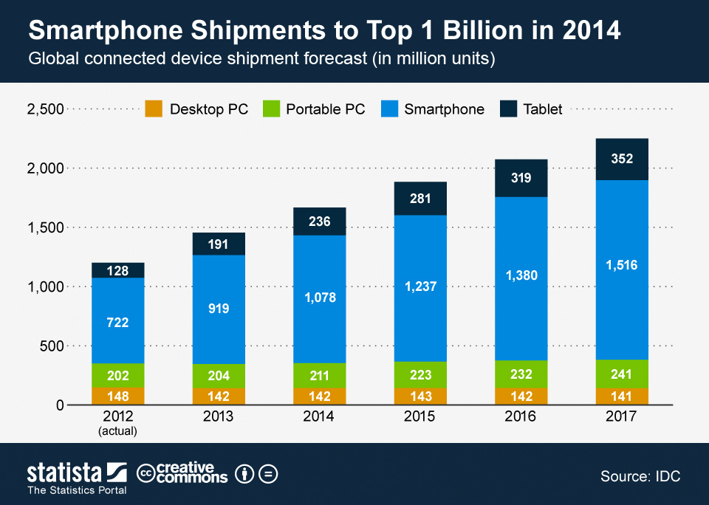
Growing Smartphone Market Worldwide Smart Connected Devices Market Forecast Unit Shipments (Millions)
Notes:
The global smartphone market has kept growing over the past years, nowadays, more than 1.5 billion smartphone are sold world wide.

Slide 3
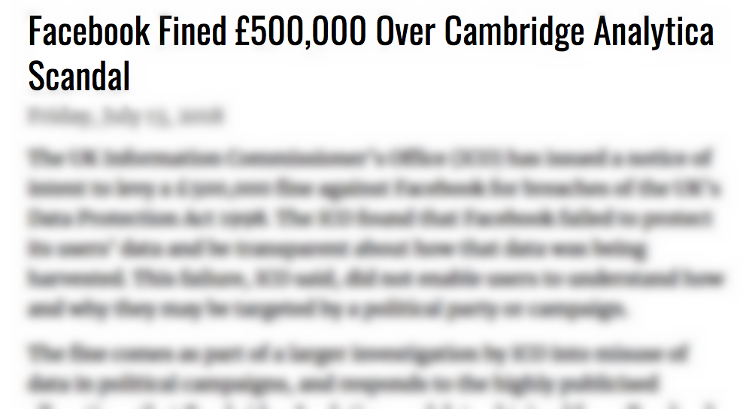
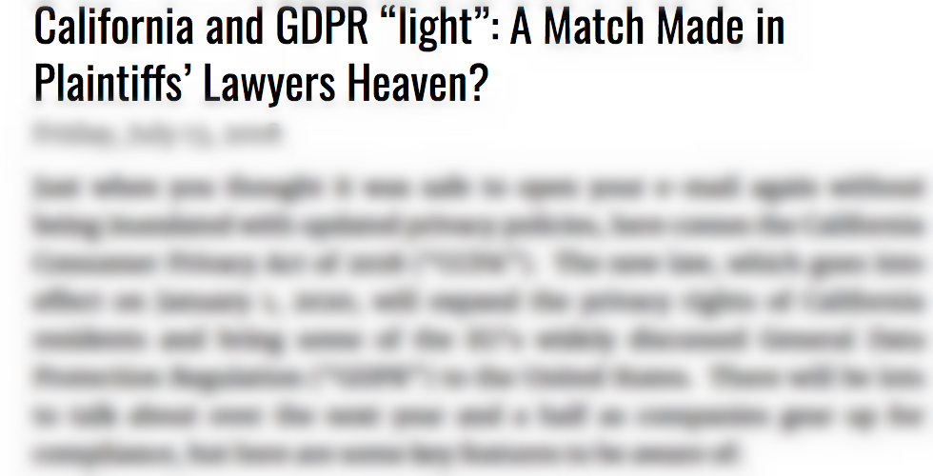
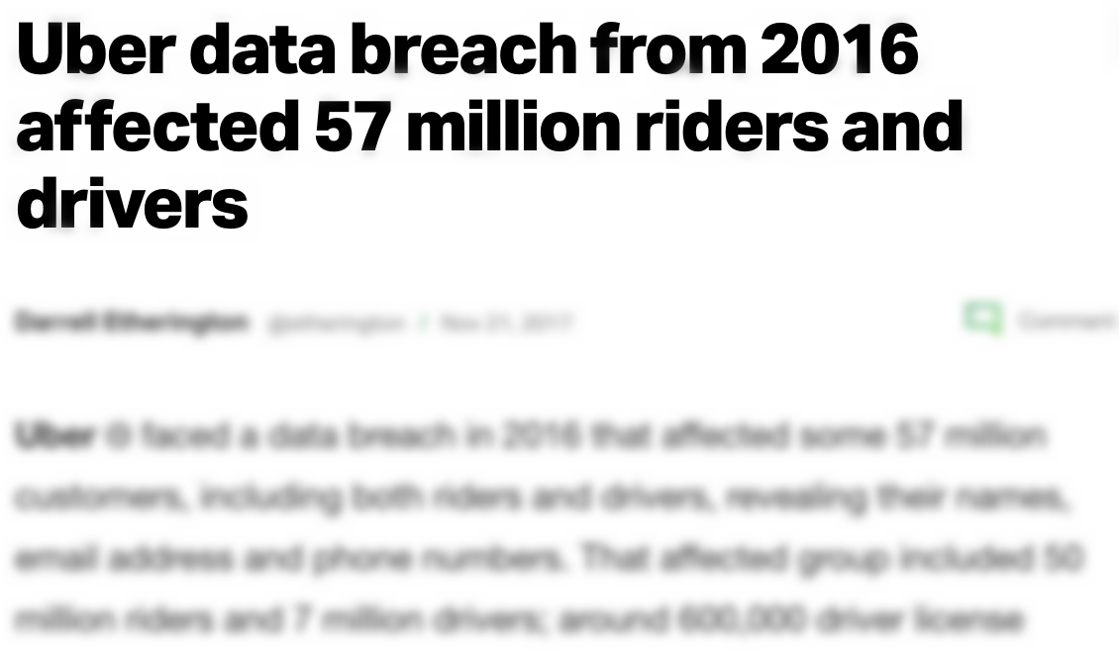
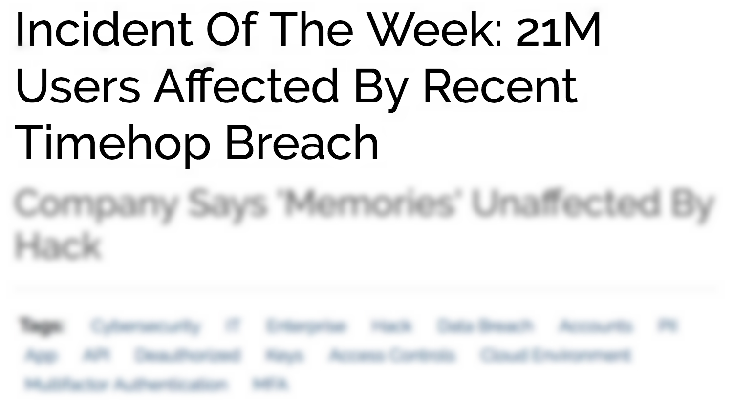
Growing Challenges in Android Security
Notes:
As the popularity of smartphones keeps growing, the industry also faces more and more challenges in protecting user privacy.
Earlier this year, we all heard about Cambridge Analytica, the company that harvested 87 million user profiles by requesting access to their Facebook logins.
In recent years, we have seen a lot of similar data breach incidents. Every time, millions of users got their personal information leaked.

Slide 4
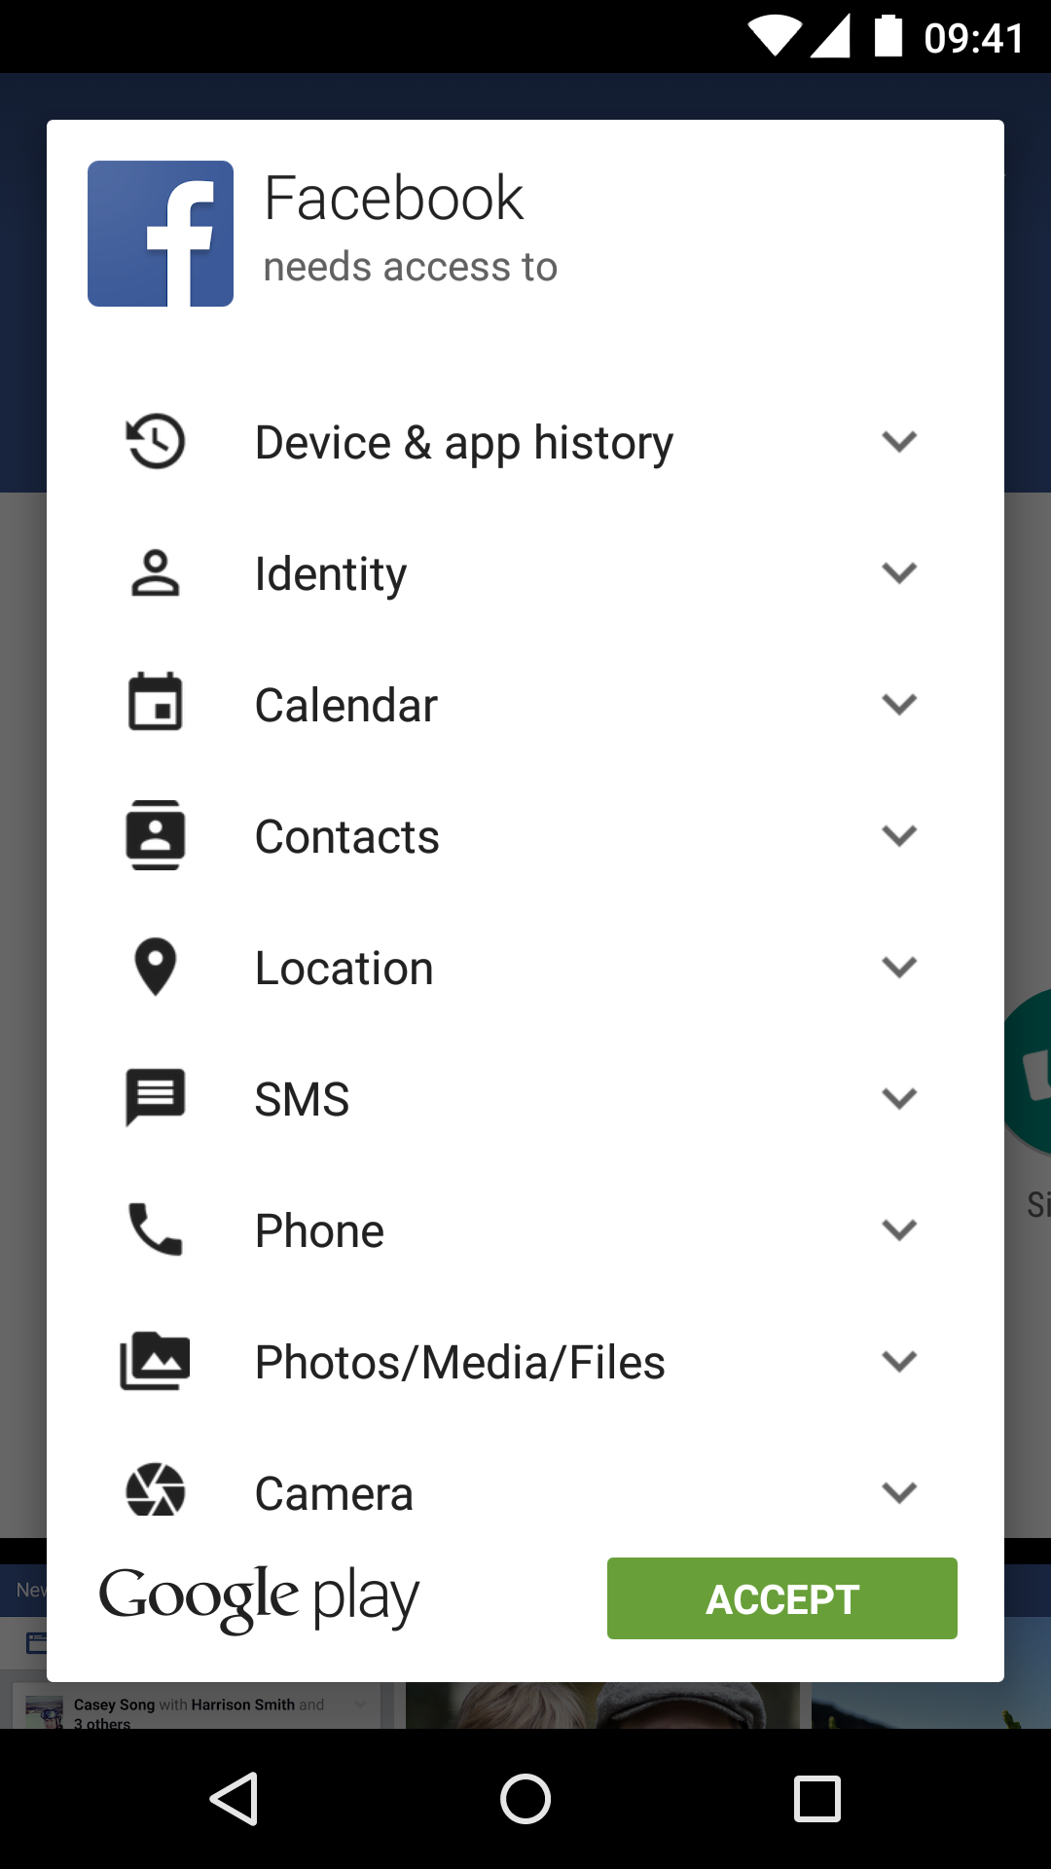
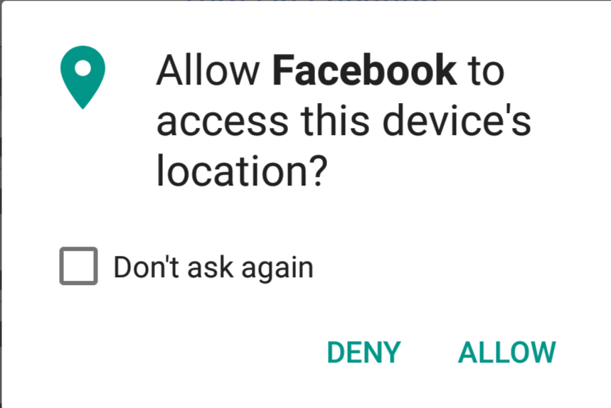
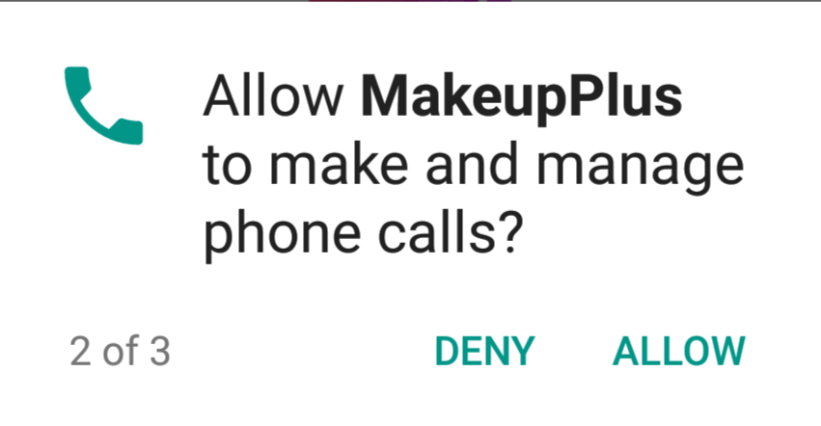
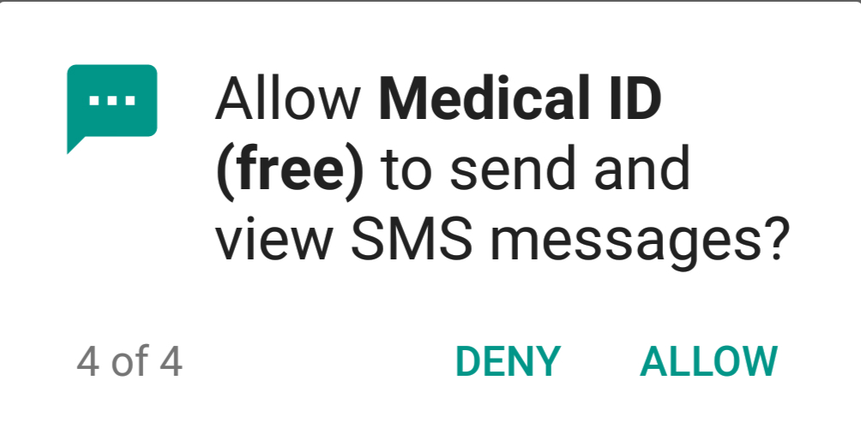
Android Permission Requests
Notes:
The way Android protects users’ private information is through the Android permission system.
The permission system controls users’ private data resources such as location, contact list, and so on, and users must grant these permissions before the app can access their information.

Slide 5
Understanding Permission Purposes
Why does Facebook need my location?
User understanding toward permission [Felt et al. 12]
Permission: location
Notes:
However, existing work shows that there’s a knowledge gap between user understanding and the technical permission usage.
Users often don’t understand what the permissions are used for.

Slide 6
Explaining Permission Purposes
Facebook:
“…Find local social events, and make plans...”
Reduce users’ security concerns [Lin et al. 12]
Challenge for apps to explain permission purposes?
Permission: location

Slide 7
3 Challenges in Explaining Permissions: Technical Jargon
GeoTimer: “...GeoTimer harnesses Google’s Geofence API...”
Why does Geofence API need my location?
URL: https://androidappsapk.co/detail-geotimer-lite/
(our anonymous reviewer)
Challenge 1: Technical Jargons
Permission: location

Slide 8
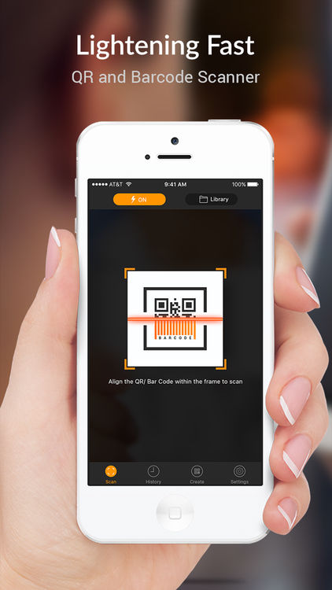
3 Challenges in Explaining Permissions: Explaining Rare Permissions
Best Barcode scanner:
Explains CAMERA
Skips LOCATION
I understand CAMERA, but why is LOCATION used?
Best Barcode scanner
[Liu et al. 18]
Barcode Scanner:
Explain CAMERA vs. explain LOCATION?
CAMERA 1.7 more frequent than LOCATION!
URL: https://play.google.com/store/apps/details?id=com.best.qrbarcodescanner
CAMERA
Challenge 2: Explaining Rare Permission
Challenge 1: Technical Jargons
Permission: location

Slide 9
3 Challenges in Explaining Permissions: Deciding the Best Specificity
Orlando theme park: “…essential for many useful features in tripwolf , such as locating yourself on the map , routing, finding nearby sights , wifi hot spots , atms , public transport stations and much more…”
Orlando theme park: “park locator”
Too long!
Too vague!
URL: https://play.google.com/store/apps/details?id=com.tripwolf.miniapp_869403_free
Challenge 1: Technical Jargons
Challenge 2: Explaining Rare Permissions
Challenge 3: Specificity Requirements
Challenge 3: Specificity Requirements
Permission: location

Slide 10
How to Help Apps Write User-Understandable Explanations?
Related work
WHYPER: Explaining permission purposes using app description sentences [Pandita et al. ‘13]
CLAP: Helping Apps Write and Improve their Permission Explanations
Main idea:
Recommend permission explanations in similar apps (CoLlaborative App Permission Recommendation)
Notes:
Android apps have practiced explaining permissions in their description and privacy documents.
In the later version of Android after 6.0, many apps have already provided runtime permission rationales. Runtime rationales are message dialogs that appears when user is using the app, like “we need to use your location for weather report”, etc.
In particular, WHYPER paper proposes to use app description sentences to explain permissions by matching them against API documents

Slide 11
A Use Case of CLAP
Requirements engineer
CLAP
locate stores near you
Locator inside the store
use the map view to locate a store near you
“Store locator”
LOCATION
CAMERA
…
“Locate stores near you”
AndroidManifest.xml
“Locate stores near you with map view”
Permission: location
Notes:
Here’s an example of how we envision CLAP to help developers with creating explanations.
The developer needs to explain the permission LOCATION for the app Menards, and the initial explanation he comes up with is “store locator”
Then CLAP recommends a list of explanations, after the developer sees the second two recommendations, he realizes that “store locator” may be ambiguous because it can also refer to locator inside the store, so he add the keyword “near you” to clarify that the location is for an outdoor locator.
Then he sees the keyword “map view” and he realizes that Menards also uses map view, so he adds the keyword to his explanation. Through this process, the developer can improve the explanation.

Slide 12
Overview of CLAP
Rank Similar Apps
Post-Process Candidate
Sentences
Process Candidate Sentences
Re-rank Candidate Sentences
Detect Permission-explaining Sentences
Permission: location
Notes:
This picture shows the framework of CLAP.
First, CLAP uses a similar app ranker to find the most similar apps to the app that needs explanation.
Second, for all sentences from similar apps, CLAP build a large candidate sentence set by splitting these sentences into more candidate sentence.
Third, for each sentence in the candidate sentence set, CLAP detect if the sentence explains the target permission, and only keep those that explain the permission.
Fourth, for the left sentences in the candidate sentence set, CLAP uses a sentence ranker to select sentences with higher quality.
Finally, CLAP uses a few rules to post process these sentences to further improve the interpretability of the output sentences.

Slide 13
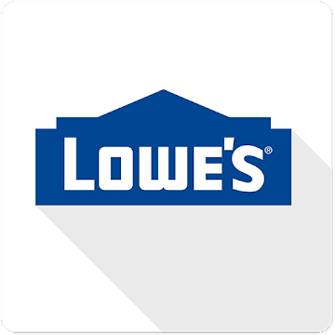
Step 1: Rank Similar Apps
Rank Similar Apps
Post-process Candidate
Sentences
Build Candidate Sentences
Re-rank Candidate Sentences
Detect Permission-explaining Sentences
Permission: location
Notes:
This picture shows the framework of CLAP.
First, CLAP uses a similar app ranker to find the most similar apps to the app that needs explanation.
Second, for all sentences from similar apps, CLAP build a large candidate sentence set by splitting these sentences into more candidate sentence.
Third, for each sentence in the candidate sentence set, CLAP detect if the sentence explains the target permission, and only keep those that explain the permission.
Fourth, for the left sentences in the candidate sentence set, CLAP uses a sentence ranker to select sentences with higher quality.
Finally, CLAP uses a few rules to post process these sentences to further improve the interpretability of the output sentences.

Slide 14
Step 2: Build Candidate Sentences
Rank Similar Apps
Post-process Candidate
Sentences
“Find nearby stores on the map”
“Obtain the driving direction”
“Nearby store locator”
…....
Build Candidate Sentences
Re-rank Candidate Sentences
Detect Permission-explaining Sentences
Permission: location
Notes:
This picture shows the framework of CLAP.
First, CLAP uses a similar app ranker to find the most similar apps to the app that needs explanation.
Second, for all sentences from similar apps, CLAP build a large candidate sentence set by splitting these sentences into more candidate sentence.
Third, for each sentence in the candidate sentence set, CLAP detect if the sentence explains the target permission, and only keep those that explain the permission.
Fourth, for the left sentences in the candidate sentence set, CLAP uses a sentence ranker to select sentences with higher quality.
Finally, CLAP uses a few rules to post process these sentences to further improve the interpretability of the output sentences.

Slide 15
Step 3: Detect Permission-explaining Sentences
Rank Similar Apps
Post-process Candidate
Sentences
“Find nearby stores on the map”
“Quickly check your Menards gift-card balance”
Build Candidate Sentences
“Scan barcode to see product details”
Re-rank Candidate Sentences
Detect Permission-explaining Sentences
Permission: location
Notes:
This picture shows the framework of CLAP.
First, CLAP uses a similar app ranker to find the most similar apps to the app that needs explanation.
Second, for all sentences from similar apps, CLAP build a large candidate sentence set by splitting these sentences into more candidate sentence.
Third, for each sentence in the candidate sentence set, CLAP detect if the sentence explains the target permission, and only keep those that explain the permission.
Fourth, for the left sentences in the candidate sentence set, CLAP uses a sentence ranker to select sentences with higher quality.
Finally, CLAP uses a few rules to post process these sentences to further improve the interpretability of the output sentences.

Slide 16
Step 4: Re-rank Candidate Sentences
Rank Similar Apps
“Find nearby stores on the map”
Post-process Candidate
Sentences
store
map
nearby
…
“Locate the stores around your location”
“Store navigator with a map view”
Build Candidate Sentences
“…”
Re-rank Candidate Sentences
“For weather report”
Detect Permission-explaining Sentences
Permission: location
Notes:
This picture shows the framework of CLAP.
First, CLAP uses a similar app ranker to find the most similar apps to the app that needs explanation.
Second, for all sentences from similar apps, CLAP build a large candidate sentence set by splitting these sentences into more candidate sentence.
Third, for each sentence in the candidate sentence set, CLAP detect if the sentence explains the target permission, and only keep those that explain the permission.
Fourth, for the left sentences in the candidate sentence set, CLAP uses a sentence ranker to select sentences with higher quality.
Finally, CLAP uses a few rules to post process these sentences to further improve the interpretability of the output sentences.

Slide 17
Step 5: Post-process Candidate Sentences
Rank Similar Apps
“Store navigator with a map view”
Post-process Candidate
Sentences
“Store navigator with a map view (for location) ”
“To send a message”
Build Candidate Sentences
Re-rank Candidate Sentences
“To send a message (from/to contacts) ”
Detect Permission-explaining Sentences
Notes:
This picture shows the framework of CLAP.
First, CLAP uses a similar app ranker to find the most similar apps to the app that needs explanation.
Second, for all sentences from similar apps, CLAP build a large candidate sentence set by splitting these sentences into more candidate sentence.
Third, for each sentence in the candidate sentence set, CLAP detect if the sentence explains the target permission, and only keep those that explain the permission.
Fourth, for the left sentences in the candidate sentence set, CLAP uses a sentence ranker to select sentences with higher quality.
Finally, CLAP uses a few rules to post process these sentences to further improve the interpretability of the output sentences.

Slide 18
Evaluation
RQ1: Are sentences recommended by CLAP relevant to the true purpose?
Large-scale quantitative study
RQ2: Are sentences recommended by CLAP interpretable?
Qualitative study
Notes:
Next, we present our evaluation results.
We want to evaluate how can the recommended sentence help the developer in writing sentences that user can better understand.
We identify two relevant characteristics of the sentence:
First, the recommended sentence needs to be relevant, because if it’s not relevant, it’ll be a waste of time for developer to read it.
Second, to help user better understand the purpose, the sentence should be interpretable and convey a concrete purpose.
For the first question, we use a quantitative study to measure the relevance.
For the second question, because it’s difficult to capture the interpretability, we use a qualitative study to observe the interpretability.

Slide 19
RQ1: Dataset
PlayDrone (1.4 million apps)
True purpose sentences
App specified permission purposes: 827 apps, e.g., “--Permission Usage--: LOCATION: Location is used for Geofence API”
Author labeled permission purposes: 96 apps
Notes:
In order to evaluate the relevance of a sentence with the purpose of current app, we need ground truth of the current app’s purpose.
It is challenging because apps usually don’t mention their permission usage purpose.
How to find such data? Normally, app don’t provide explicit explanations for their permission purpose, but we find a small number of apps have included a permission purpose block in the app description, which is approximately 2 per mille of the apps. So we call this dataset Qdev
In addition to Qdev, we manually collect a second dataset Qauthr, which are labeled by two of the authors.
The two dataset are complimentary to each other. The developer labeled permissions should be closer to the true purpose, but the apps in this dataset usually contain longer descriptions so there’s some length bias while Qauthr doesn’t have length bias.

Slide 20
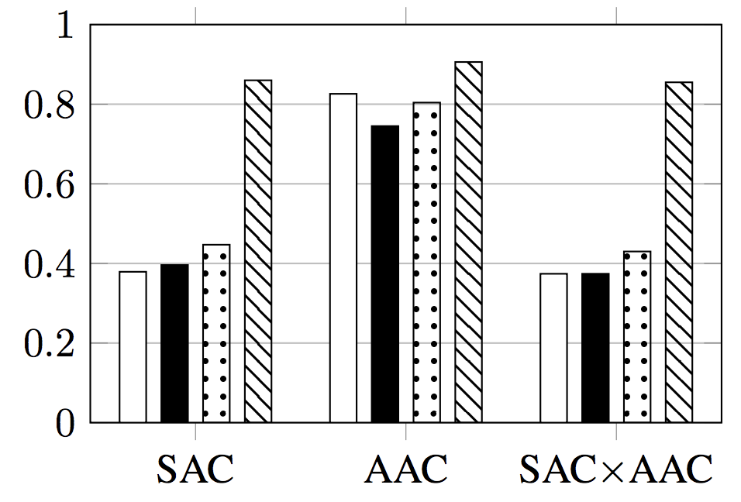
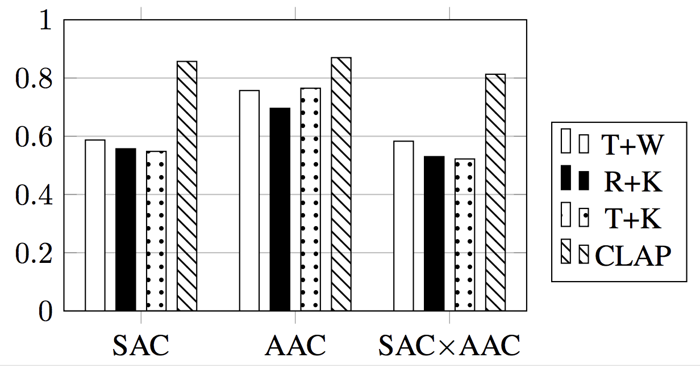
RQ1: Relevance of Recommended Sentences
SAC: sentence accuracy
AAC: app accuracy
SAC x AAC: sentence & app accuracy
CLAP’s relevance scores significantly outperform baselines!
CLAP’s accuracy ~ 85%!
Notes:
The evaluation on the author labeled dataset also shows that CLAP outperforms the baseline, and the result shows that CLAP has good accuracy.
This result can be interpreted as more than 80% apps in the top 20 are relevant to the true purpose.

Slide 21
RQ2: Interpretability of Recommended Sentences
input app:
Builddoc
Builddoc is an easytouse project-based photo documentation application that allows you to capture field issues and assign and manage team member’s tasks….
Ground truth: to record audio and voice notes
URL: https://mightysignal.com/a/google-play/com.app.builddoc1
CLAP outputs:
Creating audio notes using the device microphone (to record voice);
Use your own (recorded) voice to create audio notes
Record voice notes to explain expenses
Compose text notes using (recorded) speech to text and voice commands;
Capture photo of a book and record reading it to your child
Creating audio notes using the device microphone (to record voice);
Use your own (recorded) voice to create audio notes
Record voice notes to explain expenses
Compose text notes using (recorded) speech to text and voice commands;
Capture photo of a book and record reading it to your child
CLAP sentences match the ground truth sentence semantically!
Permission: microphone
Notes:
In our qualitative study, we find the results of CLAP has the three characteristics:…

Slide 22
RQ2: Interpretability of Recommended Sentences
Diverse wording choices
CLAP outputs:
Creating audio notes using the device microphone (to record voice);
Use your own (recorded) voice to create audio notes
Record voice notes to explain expenses
Substantial purposes
Counter example:
“to record voice”
concise
CLAP sentences show 3 characteristics of interpretability!
Permission: microphone
Notes:
In our qualitative study, we find the results of CLAP has the three characteristics:…

Slide 23
RQ2: Quantitative Evaluation on Conciseness
(word number of output sentences)
 | CLAP | T+K | T+ W | R + W
average | 8.1 | 14.6 | 14.3 | 15.6
maximum | 31 | 174 | 174 | 86
CLAP recommended sentences are 50% shorter than baselines!
Notes:
We further conduct a quantitative evaluation on the conciseness, which is the average length of results.
CLAP clearly has the most concise outputs.

Slide 24
Discussions
Real user study
Relies on the number of similar apps

Slide 25
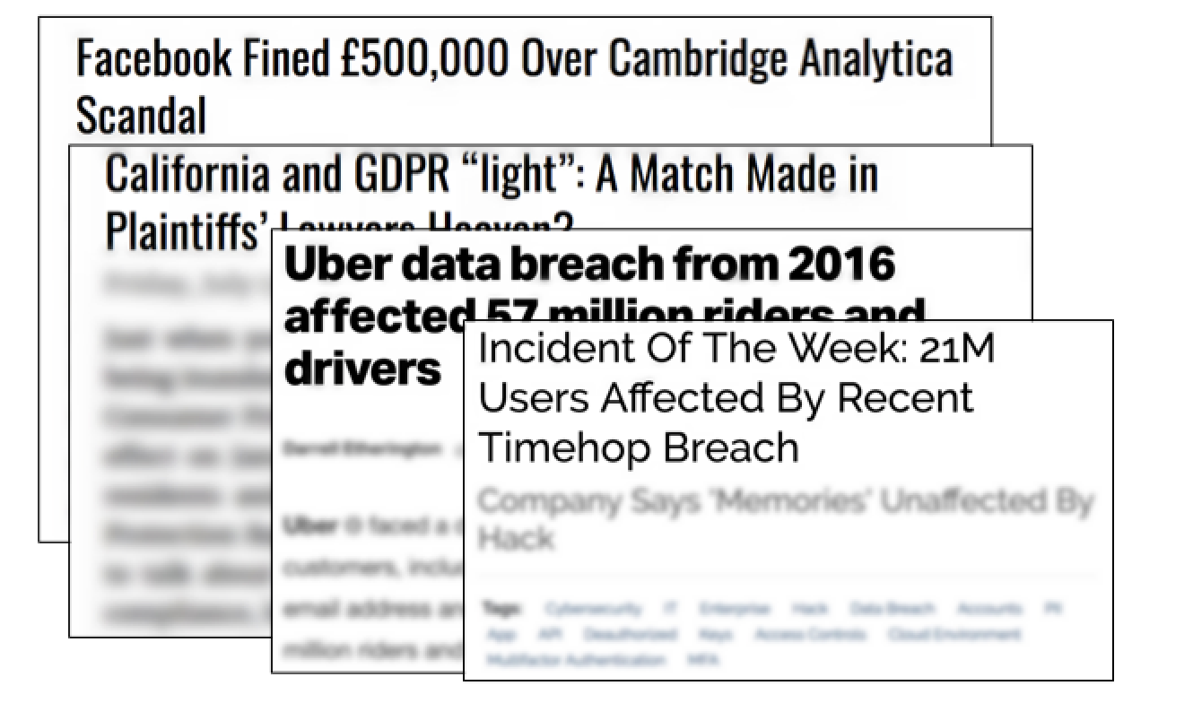
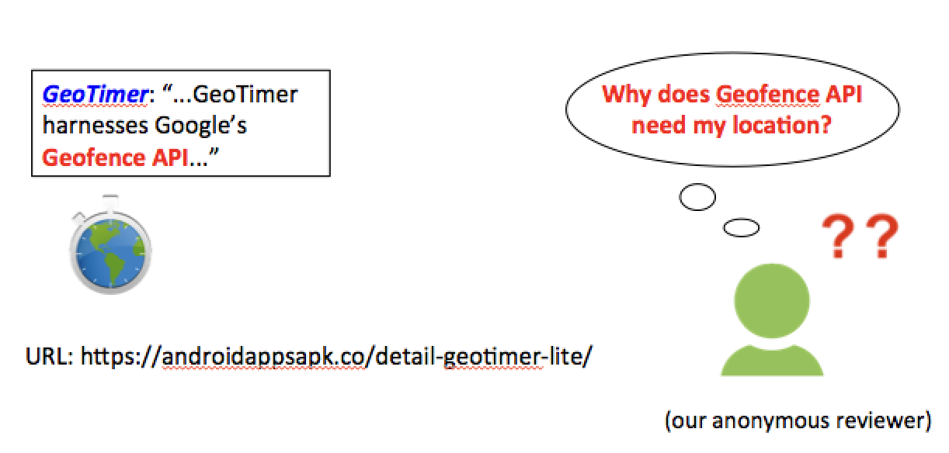
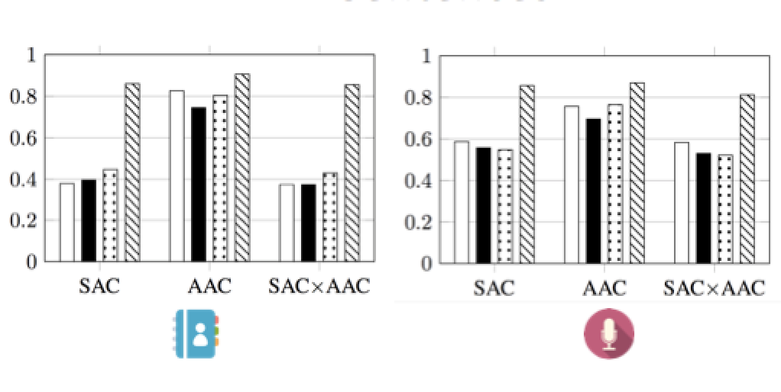
Conclusion
Challenges in Android Security
Challenges in Explaining Permissions
Higher relevance
Good interpretability

Slide 26
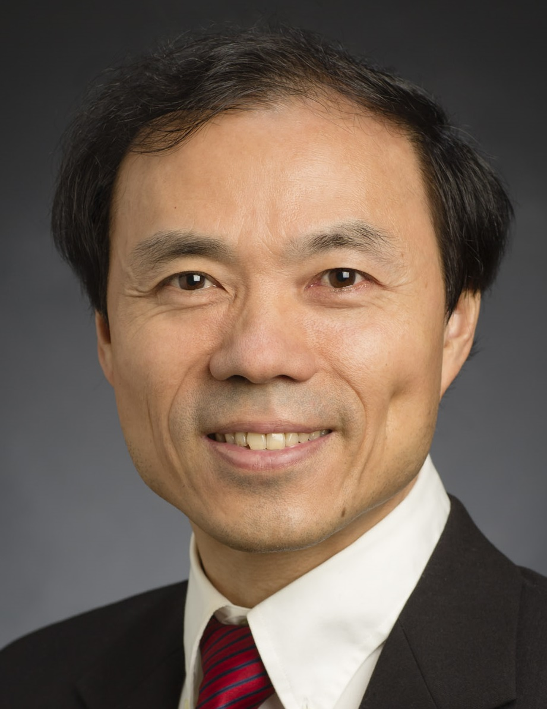
Thank you!
Cheng Zhai
Tao Xie
Acknowledgment: NSF CNS-1513939, NSF CNS-1408944, NSF CCF-1409423, and NSF CNS-1564274

Slide 27
Conclusion
Challenges in Android Security
Challenges in Explaining Permissions
Higher relevance
Good interpretability

Slide 28
Overview of CLAP
Rank Similar Apps
Post-Process Candidate
Sentences
Process Candidate Sentences
Re-rank Candidate Sentences
Detect Permission-explaining Sentences
Permission: location
Notes:
This picture shows the framework of CLAP.
First, CLAP uses a similar app ranker to find the most similar apps to the app that needs explanation.
Second, for all sentences from similar apps, CLAP build a large candidate sentence set by splitting these sentences into more candidate sentence.
Third, for each sentence in the candidate sentence set, CLAP detect if the sentence explains the target permission, and only keep those that explain the permission.
Fourth, for the left sentences in the candidate sentence set, CLAP uses a sentence ranker to select sentences with higher quality.
Finally, CLAP uses a few rules to post process these sentences to further improve the interpretability of the output sentences.

Slide 29
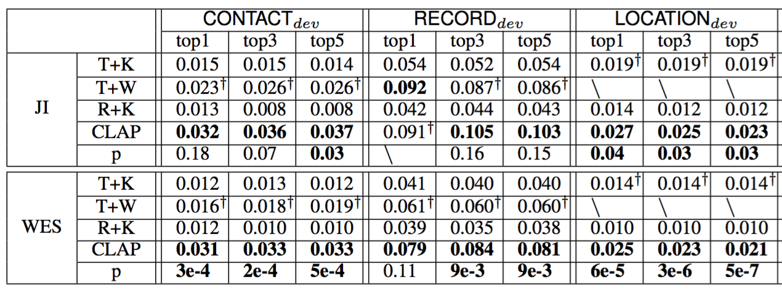
RQ1: Relevance of Recommended Sentences
Jaccard Index: (exact-match)
Word embedding similarity (semantic)
T test between CLAP (bold) and the second best baseline (dagger)
CLAP’s relevance scores significantly outperform baselines!
Notes:
We compute the results of CLAP and three baselines, and run T-test between CLAP and the second highest baseline.
The result of WES is significant.
The difference between WES and JI is that WES captures more semantic similarity.

