Slide 1
CS 589 Fall 2020
Learning to rank
web search
Instructor: Susan Liu
TA: Huihui Liu
Stevens Institute of Technology

Slide 2
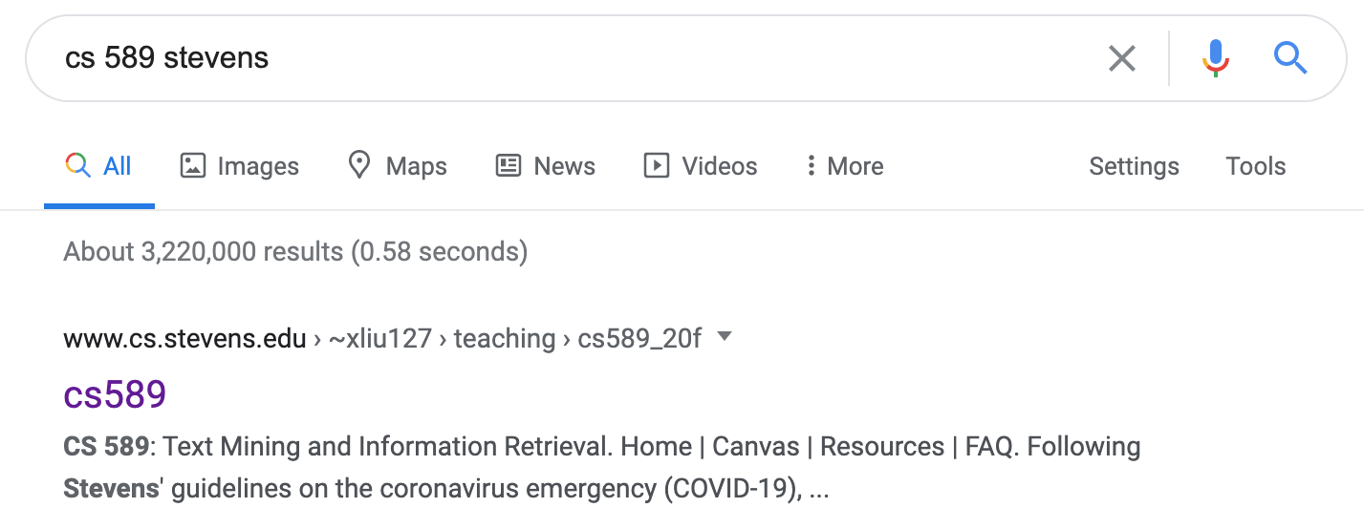
Review of what we’ve learned
How does Google know cs 589 refers to a course?
How does Google know stevens = SIT?
IR infrastructure (lecture 4)
evaluating accuracy (lecture 3)
Notes:
creates the building block of more advanced techniques

Slide 3
Recap of retrieval models
In Lecture 2, we learned how to measure the similarity between a query and a document
Notes:
we use Google playstore data as the data source, so we collect these data, we clean it, we split the sentence, and we build a filtering algorithm to select the high quality sentence

Slide 4
The disadvantage of retrieval models
Cannot adapt to users’ fine-grained intents
e.g., adapting to certain context (location, demographic information)
no personalization
Cannot naturally leverage the massive amount of user feedback signals
Formulation is complicated, difficult to tune parameter, e.g., the two-Poisson model
Difficulty choosing a retrieval model
Notes:
we use Google playstore data as the data source, so we collect these data, we clean it, we split the sentence, and we build a filtering algorithm to select the high quality sentence

Slide 5
Today’s lecture
Notes:
we use Google playstore data as the data source, so we collect these data, we clean it, we split the sentence, and we build a filtering algorithm to select the high quality sentence

Slide 6
Today’s lecture
Web search
User clicks as implicit feedback
Search engine position bias
Learning to rank
Pointwise learning to rank
Pairwise learning to rank
Listwise learning to rank
Gradient boosting decision/regression tree (GBDT/GBRT)
Notes:
we use Google playstore data as the data source, so we collect these data, we clean it, we split the sentence, and we build a filtering algorithm to select the high quality sentence

Slide 7
What is machine learning?
Machine learning
Decision tree
Naive bayes
logistic regression
…
Notes:
we use Google playstore data as the data source, so we collect these data, we clean it, we split the sentence, and we build a filtering algorithm to select the high quality sentence

Slide 8
Learning to rank
TF-IDF score = 0.5
BM25 score = 0.35
LM score = 0.3
context, e.g., location
Objective: cat vs. dog
?
Objective function: Evaluation metric, e.g., NDCG
Facial feature: [0.3, -0.2, 0.5, …]
Notes:
we use Google playstore data as the data source, so we collect these data, we clean it, we split the sentence, and we build a filtering algorithm to select the high quality sentence

Slide 9
Learning to rank
Machine learning
Learning to rank
input:
learning:
loss function:
accuracy, square loss, hinge loss
P@k, MAP, NDCG
Notes:
we use Google playstore data as the data source, so we collect these data, we clean it, we split the sentence, and we build a filtering algorithm to select the high quality sentence

Slide 10
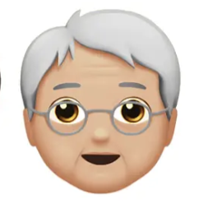
Using comparative user feedback
Learn to predict user clicks?
input:
learning:
square loss:
What is the problem of using the square loss?
Notes:
we use Google playstore data as the data source, so we collect these data, we clean it, we split the sentence, and we build a filtering algorithm to select the high quality sentence

Slide 11
Learning to rank
An important idea in the past decade of IR community
Deployed in industry search engines
Yahoo! learning to rank challenge [2011]
Why does it take so long?
Limited data access (search engine, mobile devices was popular only in the last 1-2 decades, data privacy problem)
It was possible to tune traditional IR models by hand
Notes:
we use Google playstore data as the data source, so we collect these data, we clean it, we split the sentence, and we build a filtering algorithm to select the high quality sentence

Slide 12
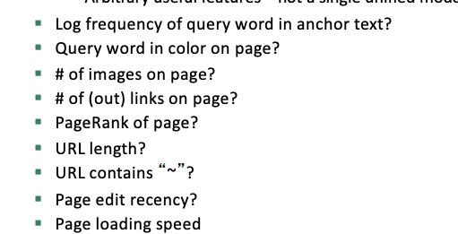
Learning to rank
Feature engineering in modern search engines
Notes:
we use Google playstore data as the data source, so we collect these data, we clean it, we split the sentence, and we build a filtering algorithm to select the high quality sentence

Slide 13
Learning to rank
Pointwise
Fit the absolute labels individually
e.g., A. Shashua and A. Levin, NIPS 2002
Pairwise
Fit the relative order
e.g., RankSVM
Listwise
Fit the metric of the entire ranked list
e.g., LambdaMART, XGBoost
Notes:
we use Google playstore data as the data source, so we collect these data, we clean it, we split the sentence, and we build a filtering algorithm to select the high quality sentence

Slide 14
Pointwise learning to rank = Regression
Reducing the ranking problem to
Regression:
Classification:
Shashua et al. Ranking with large margin principle. NIPS 2002
Cosssock et al. Subset ranking using regression. COLT 2006
Notes:
we use Google playstore data as the data source, so we collect these data, we clean it, we split the sentence, and we build a filtering algorithm to select the high quality sentence

Slide 15
Pointwise learning to rank = Regression
Collect a training corpus of (q,d,r) triples
exampleID | query ID | doc ID | cosine | bm25 | span length | … | relevance
1 | 0 | 0 | 0.032 | 0.004 | 3 |  | 0
2 | 0 | 1 | 0.02 | 0.022 | 4 |  | 1
3 | 0 | 2 | 0.043 | 0.03 | 2 |  | 0
4 | 1 | 0 | 0.027 | 0.028 | 3 |  | 1
5 | 1 | 3 | 0.009 | 0.328 | 2 |  | 1
6 | 1 | 4 | 0.04 | 0.001 | 5 |  | 0
Notes:
we use Google playstore data as the data source, so we collect these data, we clean it, we split the sentence, and we build a filtering algorithm to select the high quality sentence

Slide 16
Ranking is easier than regression
Notes:
we use Google playstore data as the data source, so we collect these data, we clean it, we split the sentence, and we build a filtering algorithm to select the high quality sentence

Slide 17
Pointwise -> pairwise learning to rank
Pointwise learning to rank:
Pairwise learning to rank (example):
Notes:
we use Google playstore data as the data source, so we collect these data, we clean it, we split the sentence, and we build a filtering algorithm to select the high quality sentence

Slide 18
Ranking based on machine learning algorithms
SVM^{Rank} (Joachims et al. 2002)
Ranking algorithm based on support vector machine
Neural network: RankNet (Burges et al. 2006)
Tree ensemble
Random forests (Breiman and Schapire)
Multi additive regression trees (Friedman, 1999)
Gradient boosted decision tree (Burges 2010)
Notes:
we use Google playstore data as the data source, so we collect these data, we clean it, we split the sentence, and we build a filtering algorithm to select the high quality sentence

Slide 19
Yahoo! learning to rank challenges
Yahoo! Webscope dataset : 36,251 queries, 883k documents, 700 features, 5 ranking levels
Ratings: Perfect (navigational), Excellent, Good, Fair, Bad
LambdaMART (Burges et al.) was the linear combination of 12 models:
8 Tree Ensembles (LambdaMART)
2 LambdaRank Neural Nets
2 MART models using logistic regression loss
Burges et al. Learning to Rank Using an Ensemble of Lambda-Gradient Models.
Notes:
we use Google playstore data as the data source, so we collect these data, we clean it, we split the sentence, and we build a filtering algorithm to select the high quality sentence

Slide 20
Regression tree
Regression tree vs decision tree
decision tree
regression tree
Notes:
we use Google playstore data as the data source, so we collect these data, we clean it, we split the sentence, and we build a filtering algorithm to select the high quality sentence

Slide 21
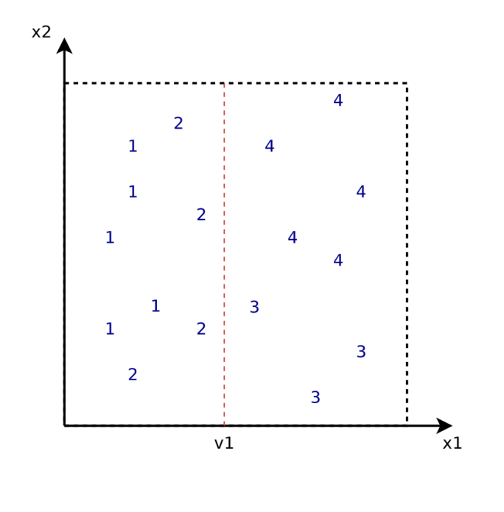
Regression tree
x^1 < v1
v4
x^1 > v3
x^2 < v4
1.444
3.625
v3
2
1.5
3
4
slides from Stanford CS276
Notes:
we use Google playstore data as the data source, so we collect these data, we clean it, we split the sentence, and we build a filtering algorithm to select the high quality sentence

Slide 22
Boosting in machine learning
AdaBoost: using the ensemble of multiple weak learners to build a high accuracy classifier
Weak learners = small decision trees (1-split decision stumps)
Weights for each learner and instance
Instances are weighed on probability it’s mistaken
Learners are weighed on its accuracy
Notes:
we use Google playstore data as the data source, so we collect these data, we clean it, we split the sentence, and we build a filtering algorithm to select the high quality sentence

Slide 23
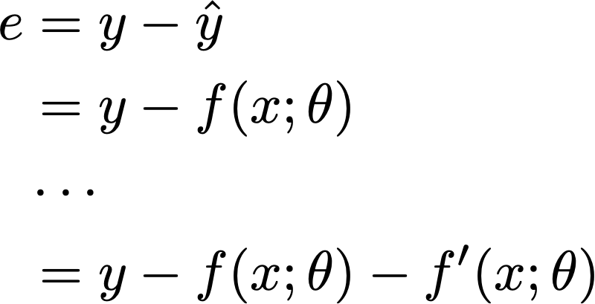
Gradient boosting regression tree
Residuals
Notes:
we use Google playstore data as the data source, so we collect these data, we clean it, we split the sentence, and we build a filtering algorithm to select the high quality sentence

Slide 24
Gradient boosting regression tree
residuals of square loss are just pseudo gradients
(which is why it’s called gradient boosting)
Notes:
we use Google playstore data as the data source, so we collect these data, we clean it, we split the sentence, and we build a filtering algorithm to select the high quality sentence

Slide 25
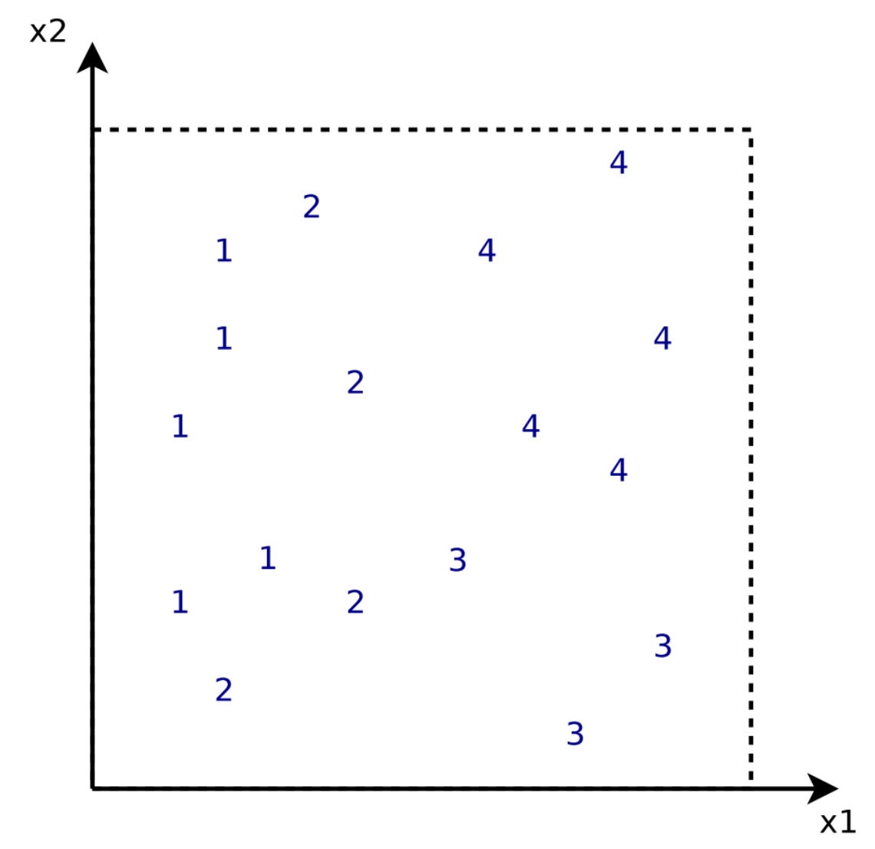
Gradient boosting regression tree example
In the first iteration, f0(x) = mean value
f0(x)
2.471
Notes:
we use Google playstore data as the data source, so we collect these data, we clean it, we split the sentence, and we build a filtering algorithm to select the high quality sentence

Slide 26
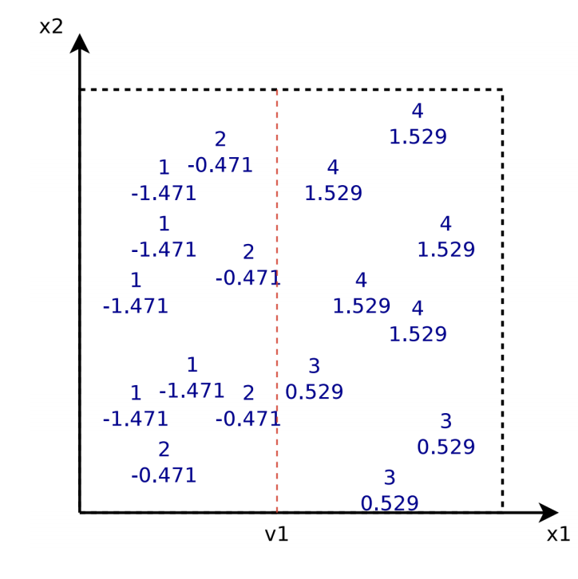
Gradient boosting regression tree example
After the second iteration, F(x) = f0(x) + f1(x)
f1(x)
f0(x)
x1 < v1
2.471
-1.027
1.154
Notes:
we use Google playstore data as the data source, so we collect these data, we clean it, we split the sentence, and we build a filtering algorithm to select the high quality sentence

Slide 27
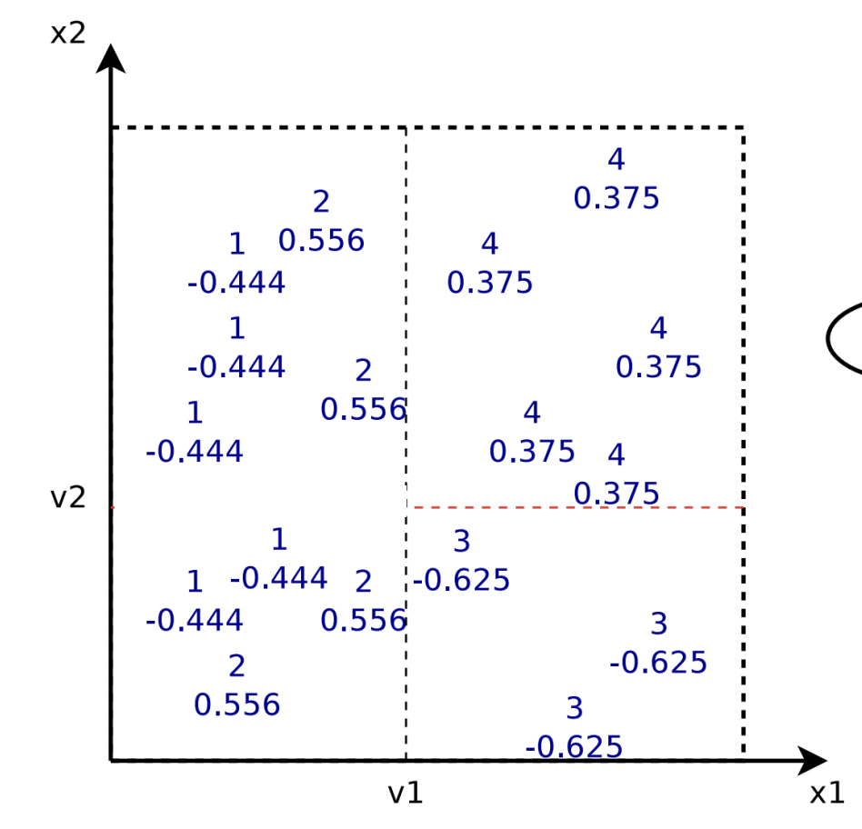
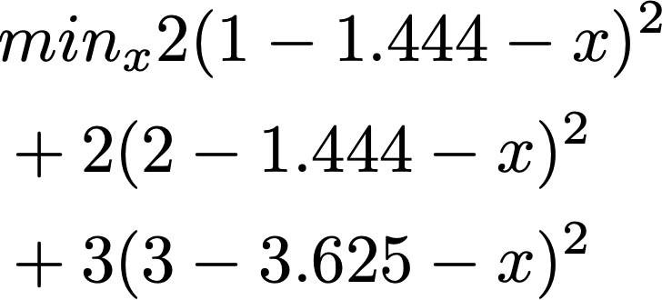
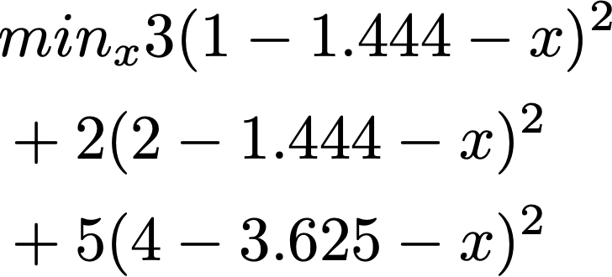
Gradient boosting regression tree example
After the third iteration, F(x) = f0(x) + f1(x) + f2(x)
f1(x)
x2 < v2
-0.236
0.166
Notes:
we use Google playstore data as the data source, so we collect these data, we clean it, we split the sentence, and we build a filtering algorithm to select the high quality sentence

Slide 28
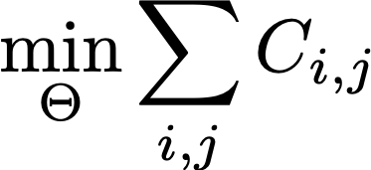
RankNet [Burges et al. 2010]
Use si to denote the ranking function:
Plugging in the probability gives rise to:
Sij = 1 if di is more relevant than dj; –1 if the reverse, and
0 if the they have the same label
Notes:
we use Google playstore data as the data source, so we collect these data, we clean it, we split the sentence, and we build a filtering algorithm to select the high quality sentence

Slide 29
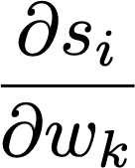
RankNet [Burges et al. 2010]
{i, j} in I: for all pairs of i, j in the data (both positive and negative)
Notes:
we use Google playstore data as the data source, so we collect these data, we clean it, we split the sentence, and we build a filtering algorithm to select the high quality sentence

Slide 30
LambdaRank
RankNet: minimize the pairwise ranking error
LambdaRank: minimize the pairwise ranking error, scale by the change in NDCG
Notes:
we use Google playstore data as the data source, so we collect these data, we clean it, we split the sentence, and we build a filtering algorithm to select the high quality sentence

Slide 31
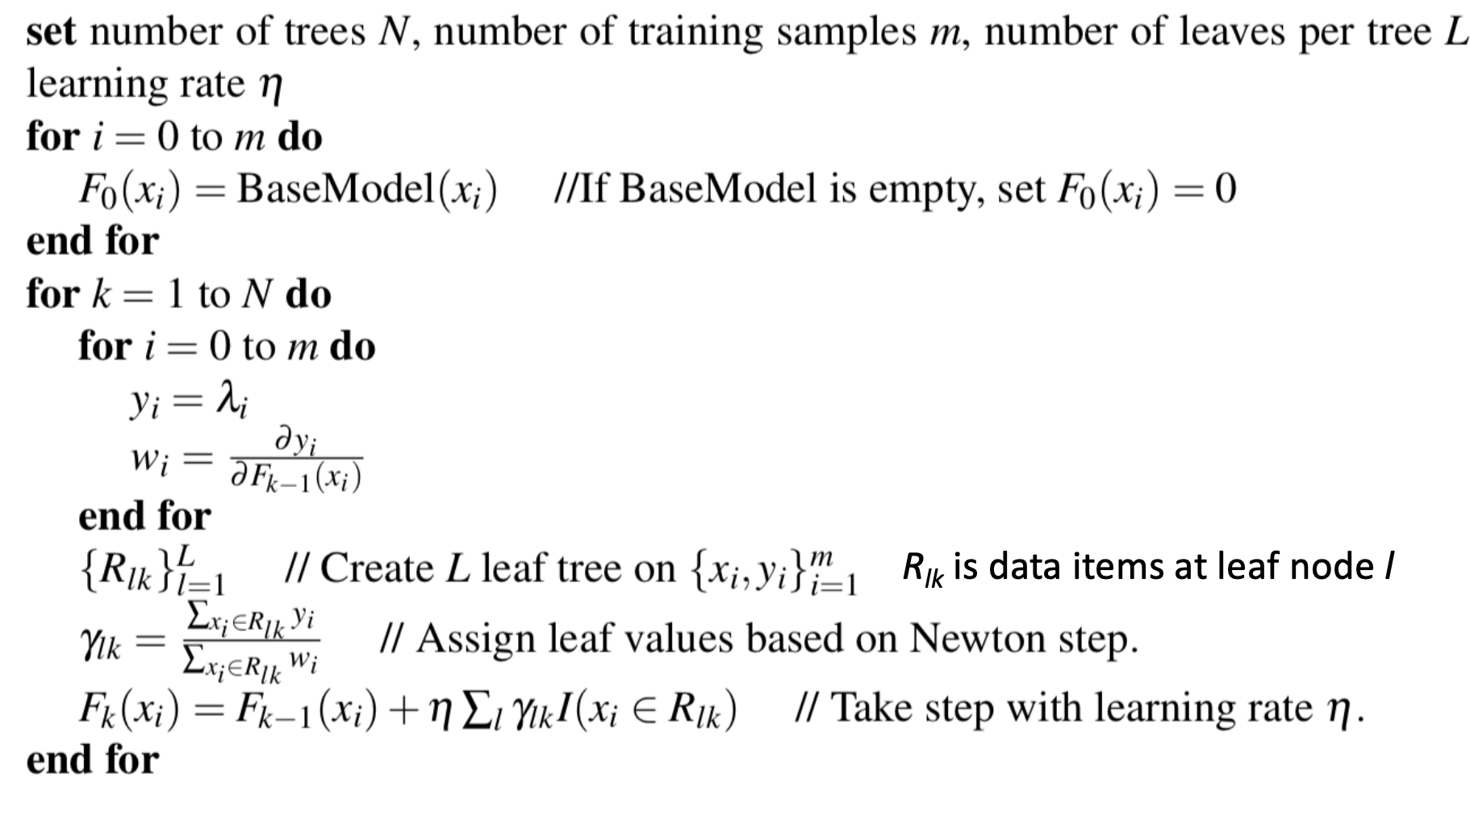
LambdaMART [Burges et al. 2010]
Lambdas are kind of “gradients” in RankNet
In MART, with the specific lambda as gradients, we get:
LambdaMART = LambdaRank + MART (gradient boosting)
Notes:
we use Google playstore data as the data source, so we collect these data, we clean it, we split the sentence, and we build a filtering algorithm to select the high quality sentence

Slide 32
XGBoost [Chen and Guestrin]
State-of-the-art algorithm for gradient boosting
Ingredients
Regularization
Gradient boosting
Approximate greedy algorithm
Weighted quantile sketch
Sparsity aware split finding
Parallel learning
…
Notes:
we use Google playstore data as the data source, so we collect these data, we clean it, we split the sentence, and we build a filtering algorithm to select the high quality sentence

Slide 33
LTR: real world use
Systems that currently used LambdaMART:
Bing, search ads
However:
Machine learning was not heavily used in Google! (why?)
Rule based systems are more interpretable and easy to debug:
From Google's dominance in web search, it's fairly clear that the decision to optimize for explainability and control over search result rankings has been successful at allowing the team to iterate and improve rapidly on search ranking quality
(answer from Quora, 2011)
https://www.quora.com/Why-is-machine-learning-used-heavily-for-Googles-ad-ranking-and-less-for-their-search-ranking-What-led-to-this-difference
Notes:
we use Google playstore data as the data source, so we collect these data, we clean it, we split the sentence, and we build a filtering algorithm to select the high quality sentence

Slide 34
LTR: real world use
In 2015, Google introduced RankBrain, a query interpretability approach
The 3rd important feature of Google
Guessing game of what ambiguous queries mean
Human: 70%
RankBrain: 80%
Notes:
we use Google playstore data as the data source, so we collect these data, we clean it, we split the sentence, and we build a filtering algorithm to select the high quality sentence

Slide 35
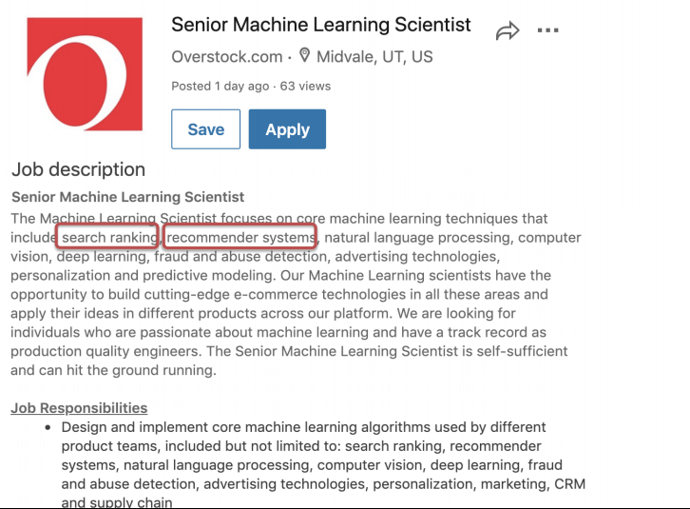
Optimizing CTR for industry search engine
Boss: I have all the user click logs (3 million records) for the last year, implement an algorithm for improving the click through rate for the next quarter
Notes:
we use Google playstore data as the data source, so we collect these data, we clean it, we split the sentence, and we build a filtering algorithm to select the high quality sentence

Slide 36
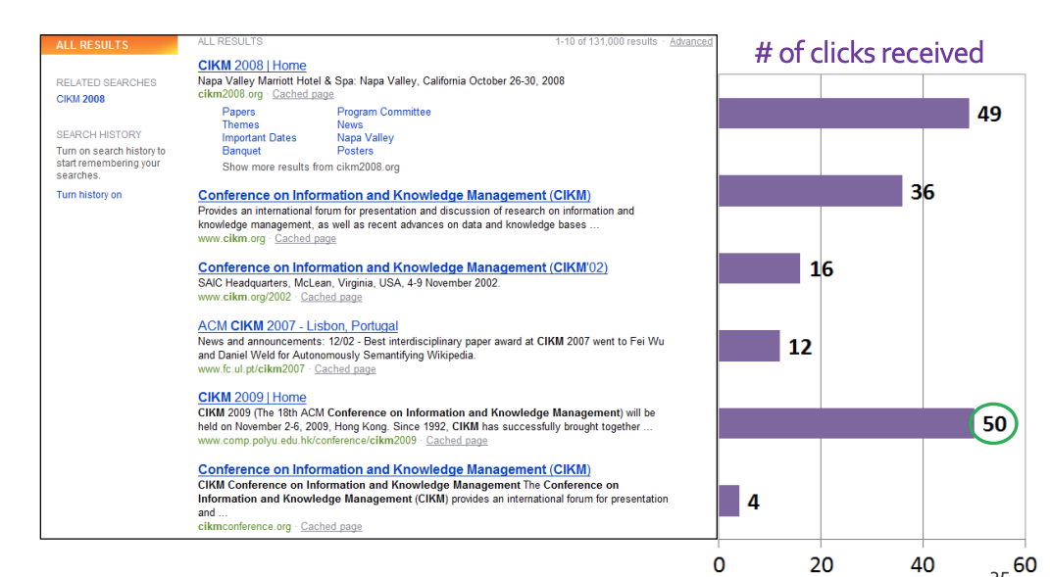
Web search: how clicks happen
query = “CIKM” (year = 2009)
Which websites are most clicked?
Relevance
Context (location, time)
Personalization
Other bias
Notes:
we use Google playstore data as the data source, so we collect these data, we clean it, we split the sentence, and we build a filtering algorithm to select the high quality sentence

Slide 37
User clicks as implicit feedback
User clicks != explicit relevance judgment
Position bias
Exploratory search: clicks on A, not click on B does not always mean A is more relevant than B
Clicks are inconsistent
User clicks ~ noisy relevance feedback
Debias the feedback
Processing user clicks for better quality
Using comparative user feedback
Notes:
we use Google playstore data as the data source, so we collect these data, we clean it, we split the sentence, and we build a filtering algorithm to select the high quality sentence

Slide 38
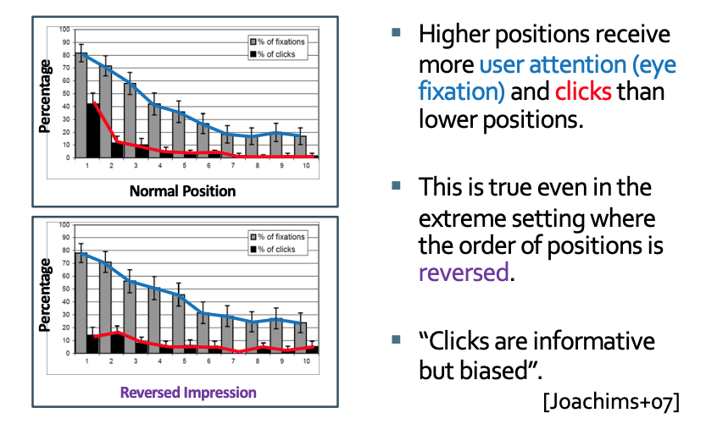
Position bias
Users always click higher ranked items, regardless of their (relative) relevance
Notes:
we use Google playstore data as the data source, so we collect these data, we clean it, we split the sentence, and we build a filtering algorithm to select the high quality sentence

Slide 39
Position bias modeling
Hypothesis testing on user click models:
Hypothesis 1: Click probability is independent of position
Hypothesis 2: Click probability is a mixture model
Hypothesis 3: Click probability follows a cascade model
Craswell et al. An Experimental Comparison of Click Position-Bias Models. WSDM 2008
Notes:
we use Google playstore data as the data source, so we collect these data, we clean it, we split the sentence, and we build a filtering algorithm to select the high quality sentence

Slide 40
Position bias modeling
Testing hypothesis using a small portion of users in a search engine
query, A, B, m
query, B, A, m
There are four types of events:
A clicked, B not clicked
B clicked, A not clicked
both A/B clicked
neither A/B clicked
Based on query,A,B,m’s result + hypothesis, estimate query, B,A,m’s result
Notes:
we use Google playstore data as the data source, so we collect these data, we clean it, we split the sentence, and we build a filtering algorithm to select the high quality sentence

Slide 41
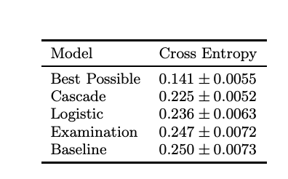
Position bias modeling [Craswell 2009]
Using cross entropy to examine hypothesis
Cascade model has the lowest CE
Notes:
we use Google playstore data as the data source, so we collect these data, we clean it, we split the sentence, and we build a filtering algorithm to select the high quality sentence

Slide 42
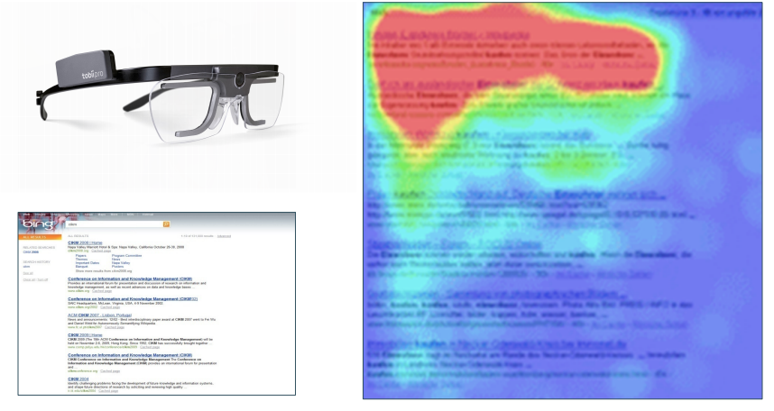
Leveraging other user signals
SAT clicks
Clicks that are long enough (> 30 sec)
Using eye tracking
Notes:
we use Google playstore data as the data source, so we collect these data, we clean it, we split the sentence, and we build a filtering algorithm to select the high quality sentence

Slide 43
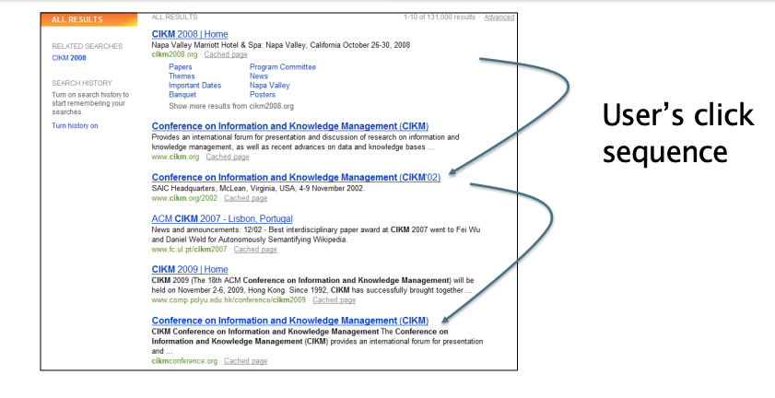
Using comparative user feedback
clicked documents are more relevant than unclicked documents (pairwise learning to rank)
Notes:
we use Google playstore data as the data source, so we collect these data, we clean it, we split the sentence, and we build a filtering algorithm to select the high quality sentence

Slide 44
Summary
Web search with user feedback
User clicks as implicit feedback
Search engine position bias
Learning to rank
Regression tree
Gradient boosting
RankNet, LambdaRank, LambdaMART
Real-world use of LambdaMART
Notes:
we use Google playstore data as the data source, so we collect these data, we clean it, we split the sentence, and we build a filtering algorithm to select the high quality sentence

